Slide 1


Slide 2
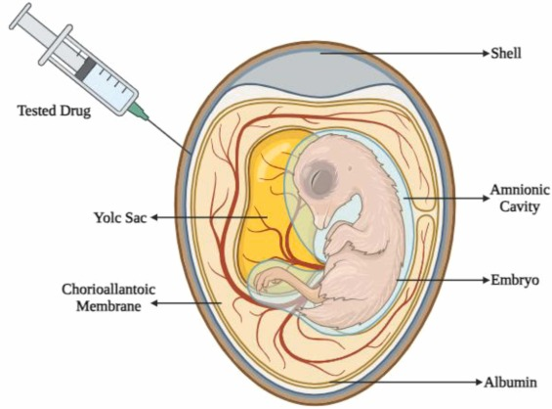

Chicken embryo: a useful animal model
By: Dr. Ahmad Khosravi

Slide 3
Advantages
*The chicken-embryo model permits controlled administration of substances and direct observation of embryonic development.
*The advantages of Chicken embryos models are largely reported in comparison with traditional mammal models, such as its low cost and reduced maturation time.
*The development of CE is rapid, corresponding to a total of 21 days9 In the first 24 hours of embryonic development, important events occur in CE formation. The first blood vessels are extraembryonic and become visible in the yolk sac (YS) from 23-24 incubation hours (IH).

Slide 4
Chicken embryos occupy a privileged place among animal models used in developmental and toxicity studies, and have also contributed significantly to immunology, genetics, virology, cancer, and cell biology, angiogenesis ,drug delivery and (nano)toxicity tests

Slide 5
Goals | Target | Route | Age at inoculation | Reference
Ophthalmology | Retinal surgery | CAM | 12 and 18 EID | 87
 | Retinal regeneration | CE | 4 EID | 88-90
Angiogenesis | Vessels of CAM | CAM | 1-5 EID | 91
 |  |  | 9 EID | 38
Ischaemia-Reperfusion | Vessels of YS | YS | 3 EID | 92
Skin | Irritation and/or toxicity | CAM | After 9 EID | 40
 | Grafting |  | 7 EID | 41
Liver | Grafting | CAM | 9 EID | 42
Regeneration of living bone | Grafting | CAM | 10 EID | 1
Spontaneous metastasis | Grafting | CAM | 10 EID | 37
Tumour | Grafting | CAM | 9 EID | 45

Slide 6
 |  |  | 8 EID | 76
 |  |  | 8 EID | 44
 |  |  | 8 EID | 43
Type I Diabetes | Drugs in the amnion | AmF | 8 EID | 46
Type 2 diabetes mellitus | Insulin-mimetic compounds | SM | 11 EID | 47
Endometriosis | Grafting | CAM | CAM (in the sharp end of the shell). Inoculation at 6 EID | 48
 | Grafting |  | 10 EID | 49
Drug | Toxicity | Yolk | 4 or 8 EID | 25
 |  | YS | 4 EID | 79,80
 |  | Albumin | before incubation, 0 EID | 78
 |  | SM | 10 EID | 24-27
 |  | CAM | 10 EID | 68
Nanosystems | Toxicity | SM | 3 EID | 71
 | Toxicity | CE | 3EID | 72
 | Angiogenic activity | CAM | 10 EID | 75
 | Angiogenic activity | CAM | 5 EID | 77
 | Antioxidant property | IV | 15 EID | 65

Slide 7
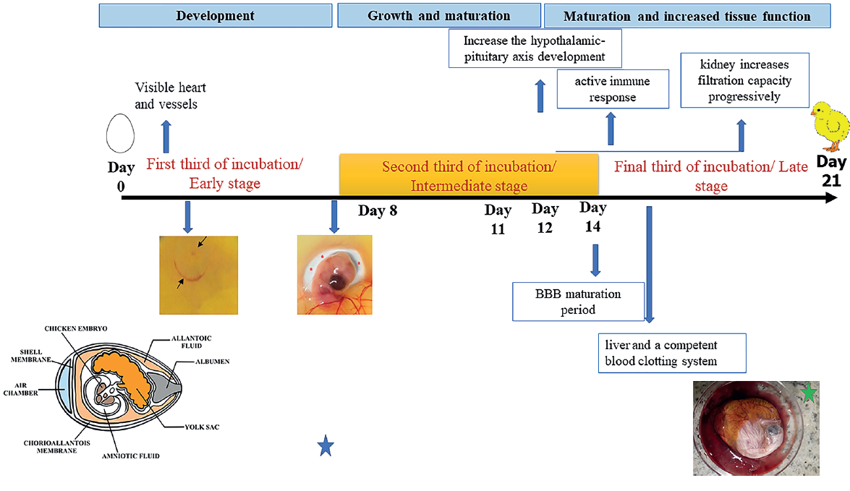

Slide 9
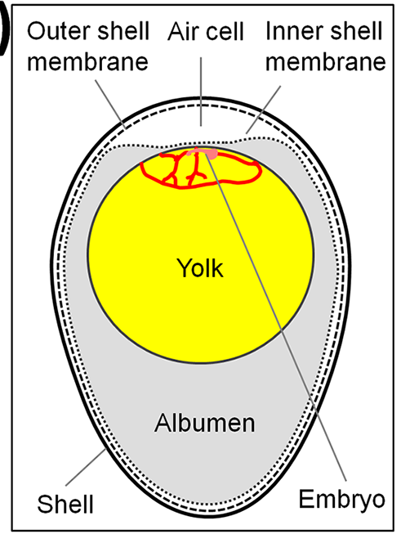

Slide 10
