Slide 1

Notes:
It may be very difficult to find a logical relationship among all these components.
But evidence-based medicine-which is commonly known as EBM-will help us to find the answer.

Slide 2
Comparative demographic, clinical, and risk profiles in Leishmania major and Leishmania tropica infections
Iraj Sharifi, PhD Leishmaniasis Research Center, KMU

Slide 3
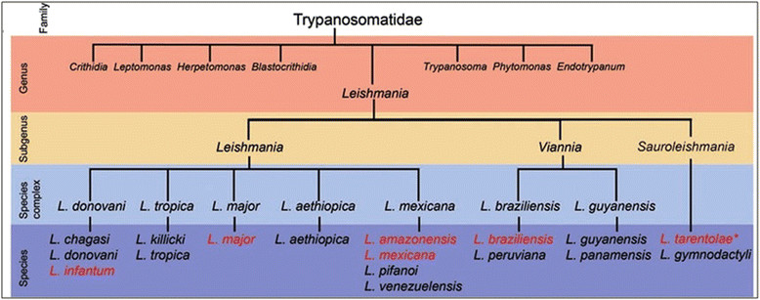
Overview of the Leishmania genus, subgenus and species complex

Slide 4
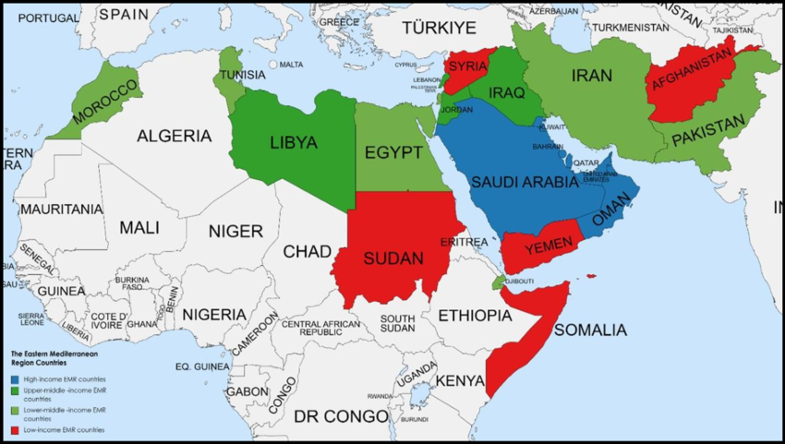
Eastern Mediterranean Region
≥8O% of CL caseloads

Slide 5
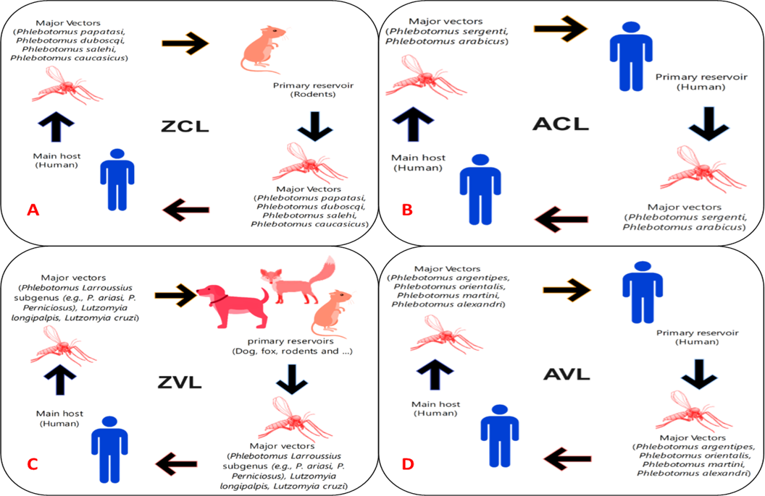
ZCL
ACL
20—30%
70-80% Cases

Slide 6
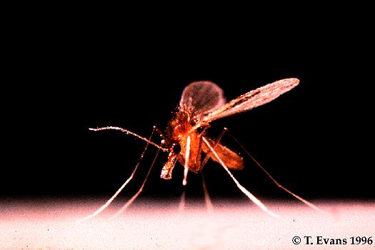
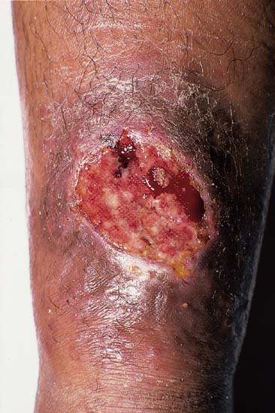
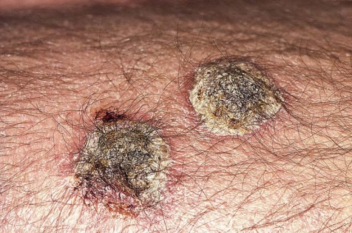
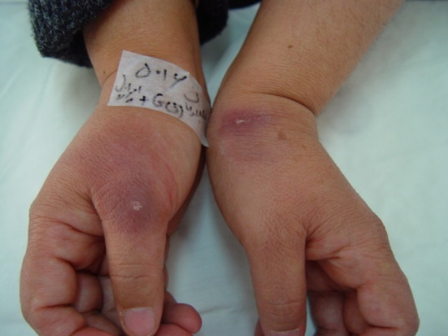
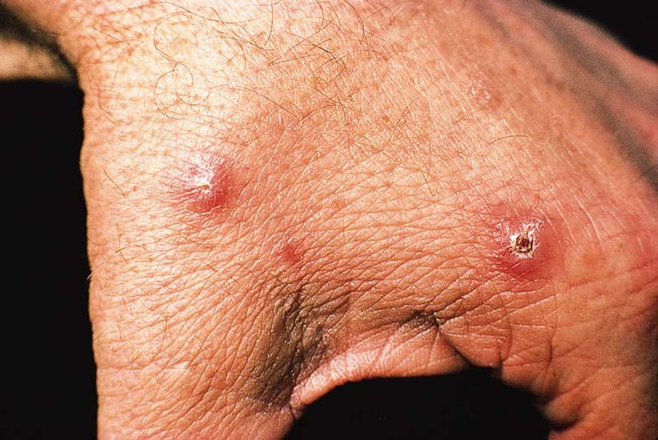
L. major:clinical course
< 2 months
After 2 weeks
2-3 months
2-6 months

Slide 7
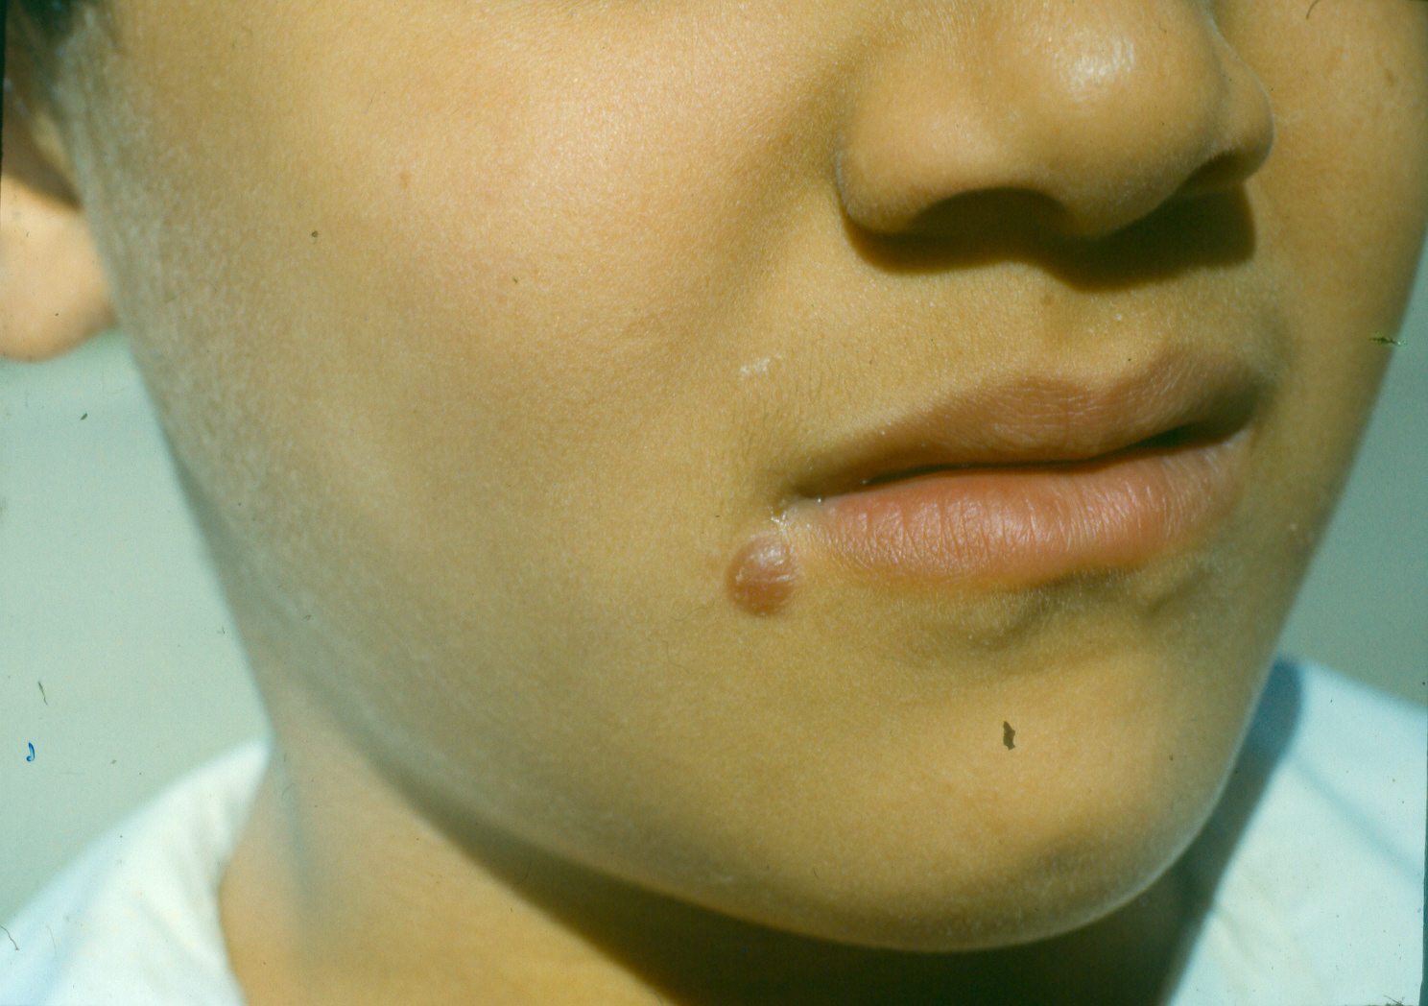
Early lesion
Papule

Slide 8
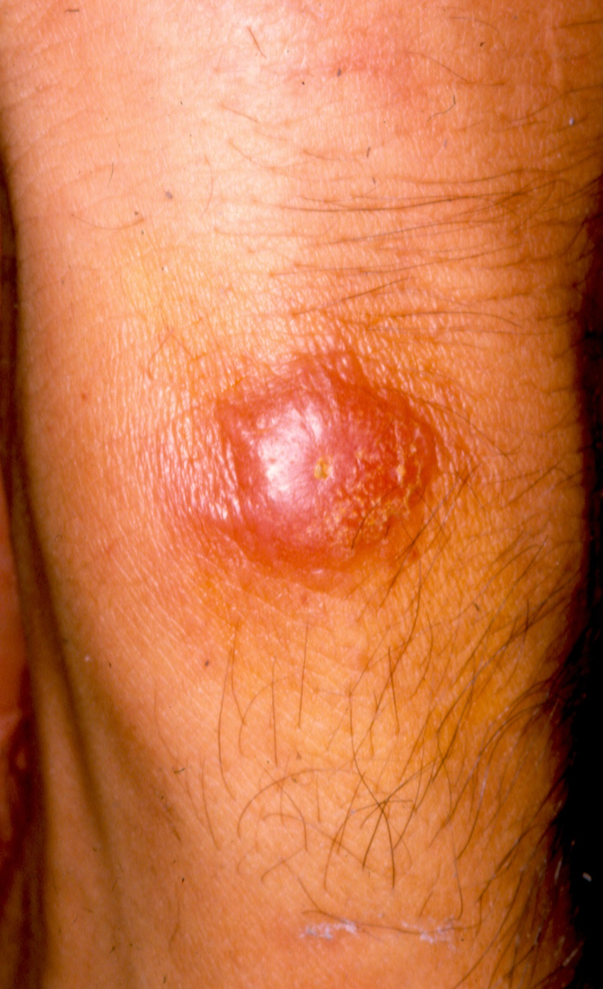
Nodule

Slide 9
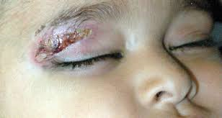

Slide 10
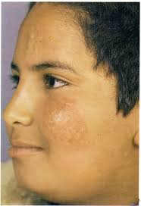

Slide 11
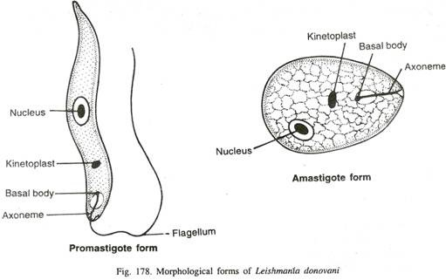

Slide 12
Sand fly vectors
L. major, Ph. papatasi (primary)
Ph. Duboseqi ( West Africa) , Ph. salehi, & Ph. bergeroti (secondary)
L. tropica, Ph. sergenti (primary)
Ph. arahica, Ph. guggisbergi, Ph. longicuspis ( occasionally in mixed foci)

Slide 13
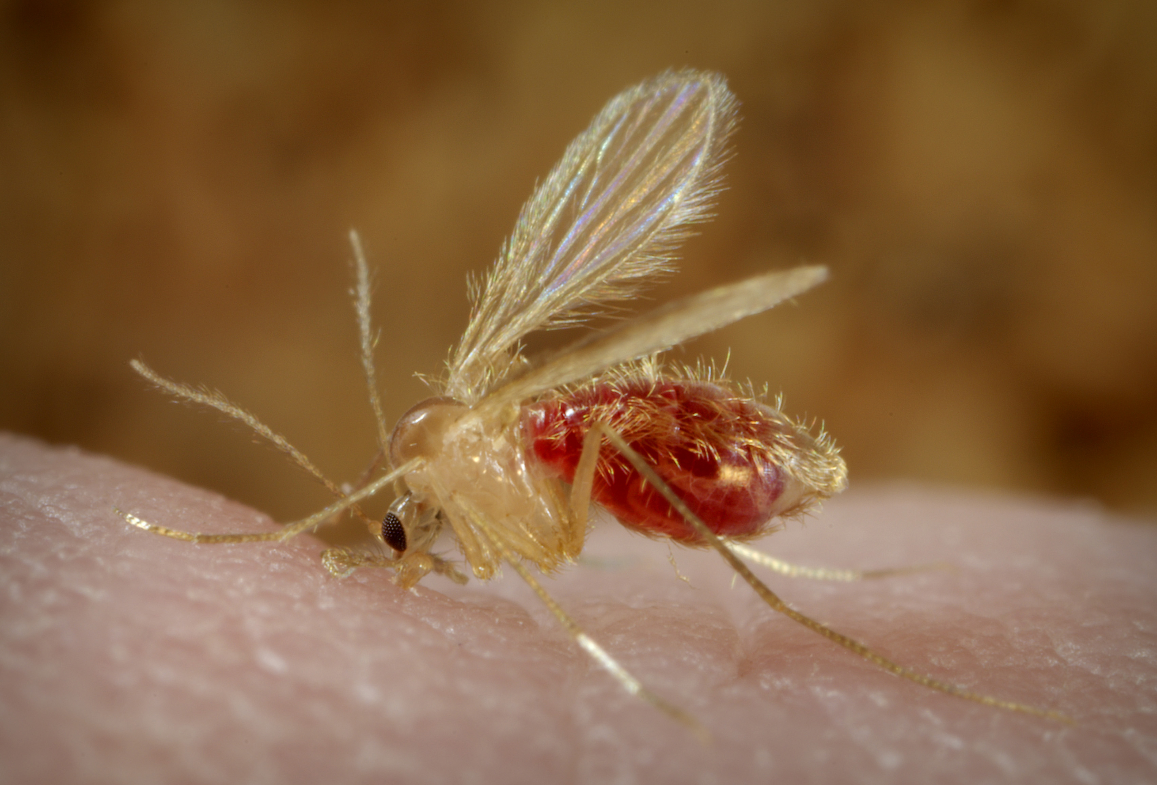
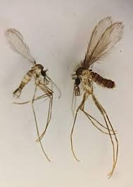
Phlebotomus spp.

Slide 14
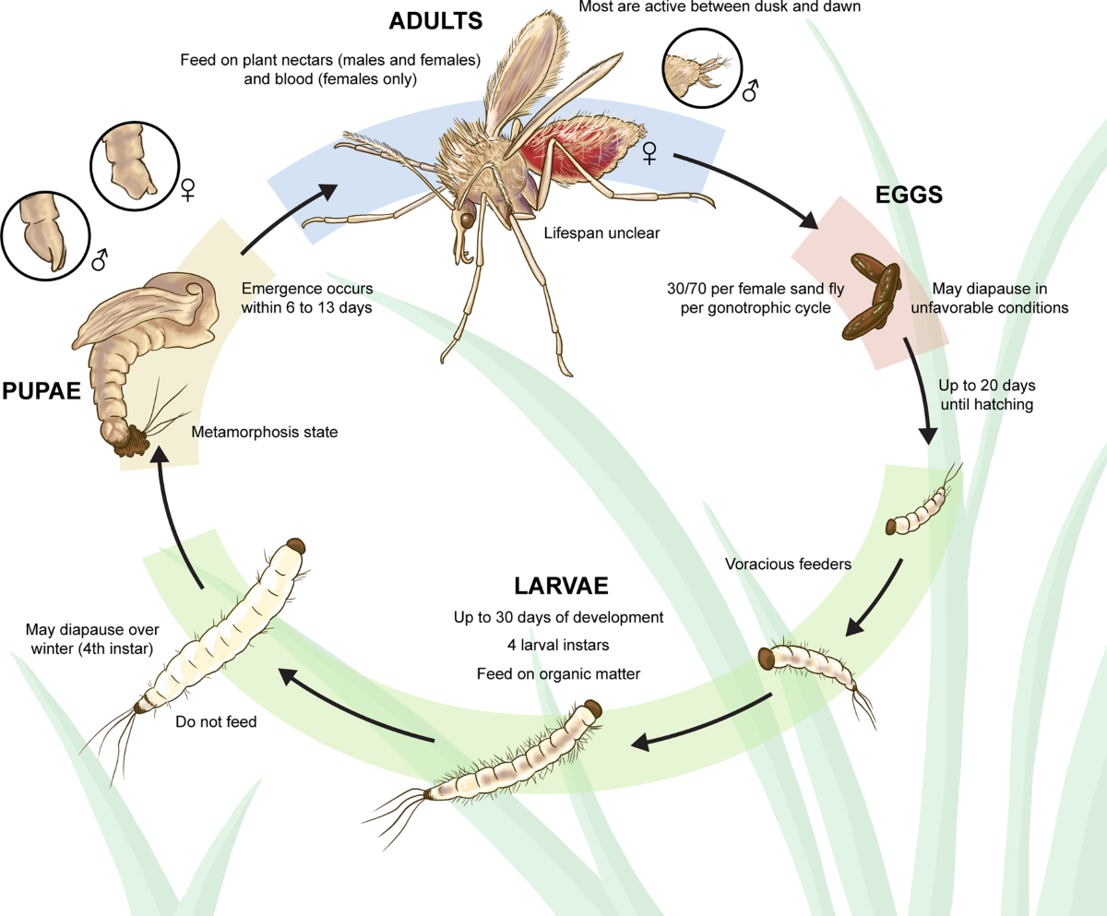

Slide 15
Sandfly breeding areas
Organic materials
Wet dwellings
Darkness
Cold places
Short flight range
Occurs in clusters-suitable environmental conditions

Slide 16
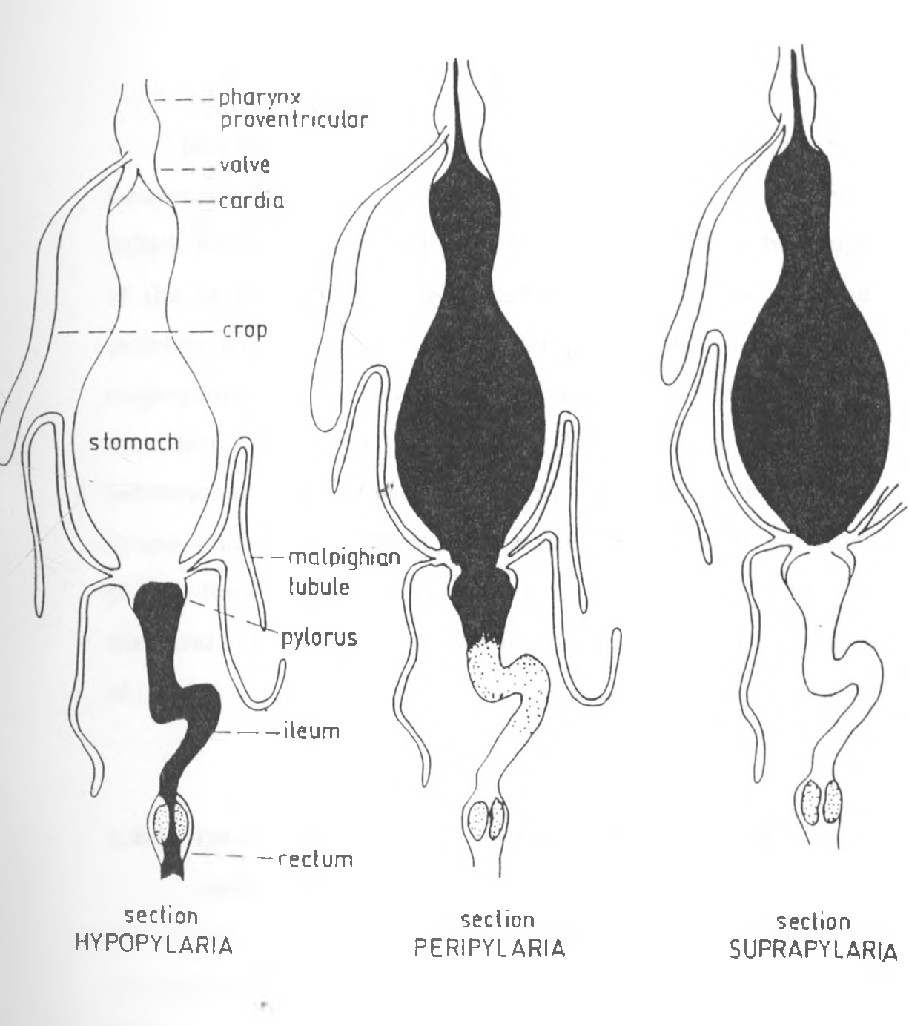
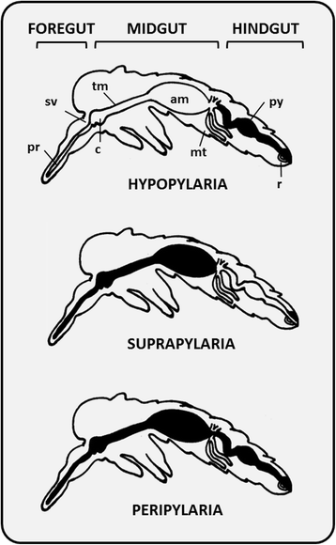
Phlebotomus spp
Viannia
Leishmania
Lutzomyia spp

Slide 17
Transmission and Reservoir hosts
L. major, zoonotic transmission
From gerbils to human
Rhombomys spp., Meriones spp., Tartara spp, Nozokia spp., and Psommomys spp.
L. tropica, anthroponotic transmission

Slide 18
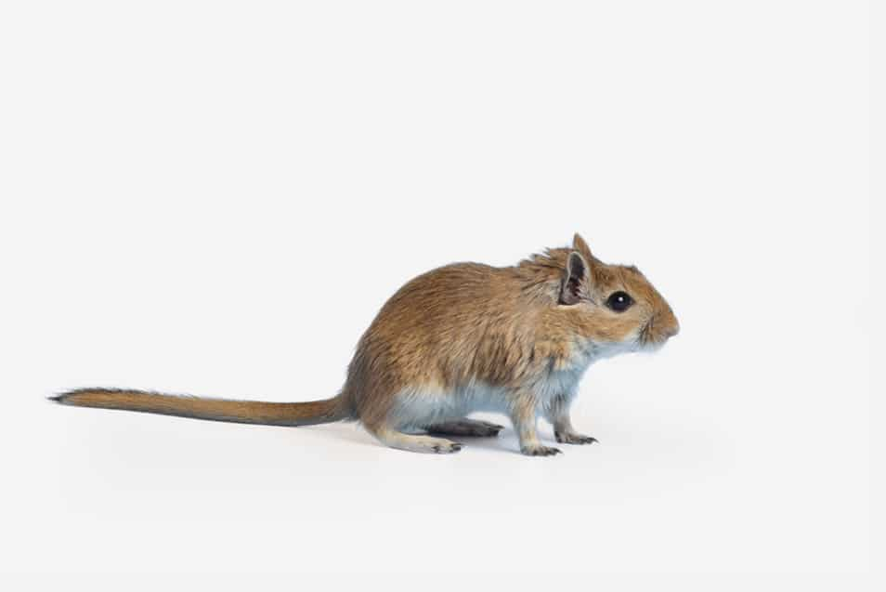
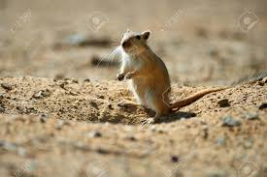
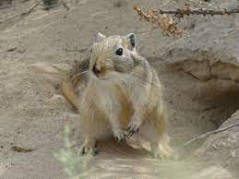
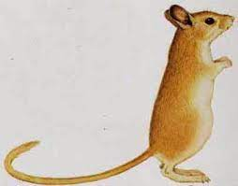
Meriones
Rhombomys
Tatera

Slide 19
Environmental and climatic RFs
L. major, in rural dry, desert-like, steppe regions, and population close to gerbils
L. tropica, in urban areas, particularly where poor waste management, over crowding and poor housing conditions

Slide 20
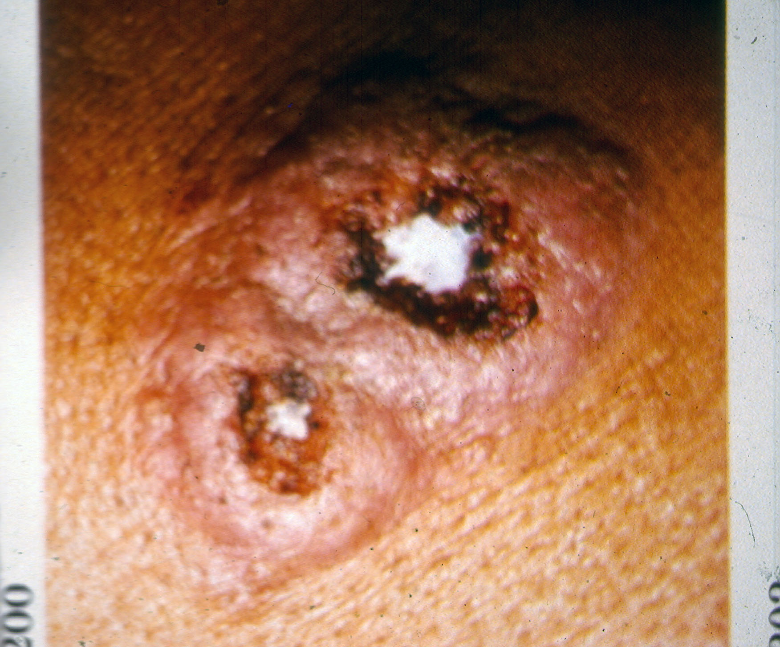
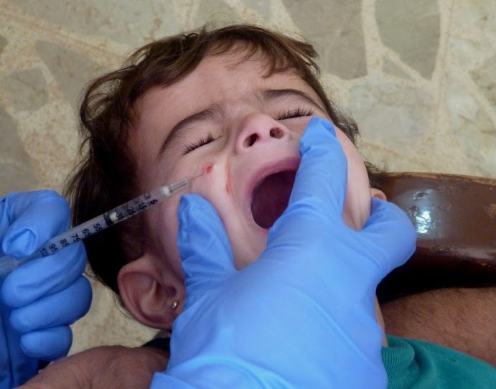
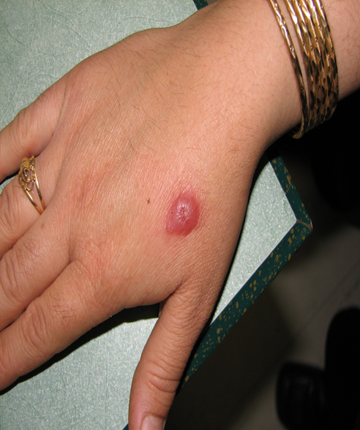
Disease characteristics
L. major, wet ZCL, acute ulcerating lesions, lesions more inflamed, heal faster
L. tropica, dry ACL, chronic course, less inflamed and potential for relapse
L. major lesion
L. tropica lesions

Slide 21
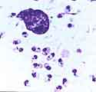
Leishmania major, few but larger in skin lesions

Slide 22
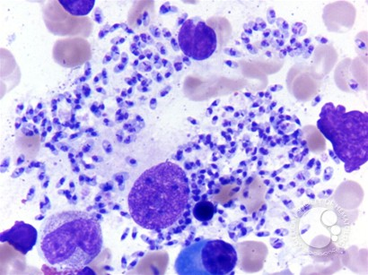
Leishmania tropica amastigotes, numerous but smaller in skin lesions

Slide 23
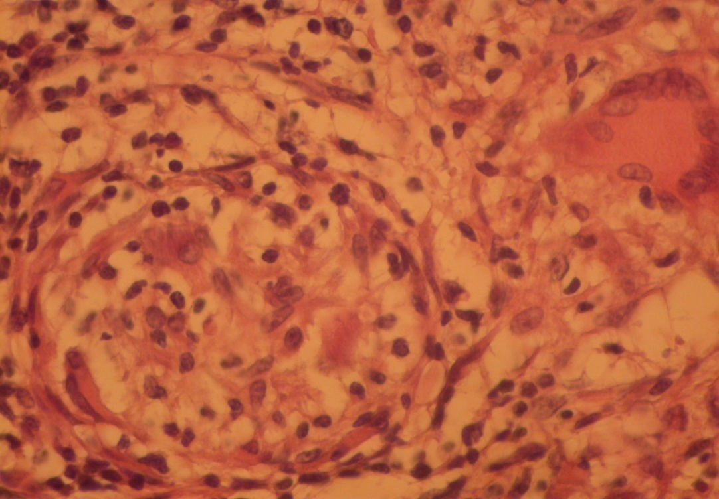
Histopathology of Leishmaniasis recidivans lesion showing typical granulomatous in filtrate composed of various inflammatory cells including lymphocytes and multinucleate giant cell (arrow) with no amastigotes.
Lupoid leishmaniasis = Leishmaniasis recidivans

Slide 24
Immunological genetic susceptibility RFs
L. major, in weakened immune systems (malnourished and immunocompromised)
Often confers immunity
L. tropica, more persistent infection with potential for chronic cutaneous lesion(some strains- highly heterogeneous)
Visceral form in immunodeficient individuals
Cause leishmaniasis recidivans (lupoid leishmaniasis)

Slide 25
Socioeconomic and behavioral RFs
L. major, more prevalent in lower-income, rural communities, more often close to animal reservoirs
L. tropica, more prevalent in crowded urban environments with poor infrastructure

Slide 26
Natural spread
L. major, movement of rodents and vectors (deforestation, desertification, agricultural expansion)
L. tropica, migration of human, population displacement, urbanization, conflicts

Slide 27
Human-mediated migration
L. major, can spread from rural to urban by laborers, trade, healthcare & occupation purposes
Military personnel, nomads, agricultural workers may introduce infections to new areas
L. tropica, spread through migration, in particular in response to war, political instability, overcrowding , refugees and mass displacement (outbreak)
Movements from endemic to non-endemic areas and vice versa

Slide 28
Environmental and climatic influence on migration
L. major, expansion is linked to changing ecosystem that support rodent populations
Deforestation , land-use changes and irrigation projects-increase range of sandfly vectors and reservoir hosts
Climate change-rising temp. and altered rainfall pattern push L. major –into new regions (L. major exclusion& L. tropica persistence/widely spread in Bam)
L. tropica
Spread is closely associated with human infrastructure
Housing conditions , waste management, and urbanization
Movement plays critical role in its spread (than climate) , spread through trade to non-endemic countries

Slide 29
Drought
Extreme droughts reduce rodents and limit spread,
Post-drought conditions lead to rodent population booms

Slide 30
Comparative demographic characteristics of L. major vs. L. tropica
Characteristics | L. major | L. tropica
Geographical distribution | Middle East, Central Asia, North Africa, parts of Sub-Saharan Africa | Middle East, Central Asia, North Africa, Afghanistan, Iran, India
Age distribution | Younger individuals, particularly children in rural areas | All age groups, often older children and adults in urban settlings
Gender distribution | Slight male preference | Male predominance
Natural habitats | Rural environments, semi-arid areas | Urban and peri-urban settings
Incidence | Seasonal peak during cold weather | All year round
Lab animal | BALB/c mice | None
Overall includes ~80% global cases
~20%
Medium/large size cities

Slide 31
Comparative clinical profile of L. major vs. L. tropica
Features | L. major | L. tropica
Incubation period | Shorter (2-4 weeks) | Loger (several months, may persist for few years in cases with no treatment
Disease course | Acute | Chronic
Healing time | Often spontaneously (typically 2-6 months) | May persist for 6-12 months or longer
Lesion type | Wet ulcerative | Dry crusted or nodular
Scarring | Common, leaves prominent atrophy | Common, less disfiguring
No. of lesions | Multiple | Usually single
Lesion Size | Larger | Smaller
Treatment approach | Needs no treatment unless vital organs are involved | Must be treated since humans are reservoirs
Treatment resistance | Less frequent | Frequent failure and relapse (Leishmaniasis recidivans)
Microbial coinfection | Frequent | Rare
Lymphadenopathy Drug susceptibility | Less frequent Fairly curable | More often (viscerotropic) More resistant

Slide 32
Comparative control strategies for L. major vs. L. tropica
Measure | L. major | L. tropica
Personal protection | Repellents (DEET) Insecticide-treated Bed nets Full clothing coverage Installing screens in front of doors and windows | Similar Similar Similar Similar
Vector control | Outdoor residual spraying (IRS) | Indoors & outdoors
Reservoir control | Focus on gerbils Early detection Prompt treatment of vital organs Habitat modification (removal of gerbil food sources) Zinc phosphide poison application | Focus on humans Early aggressive active detection Prompt treatment of patients
Surveillance | Active case detection Passive case detection | Aggressive active case detection Passive case detection

Slide 33
CL in Iran
ZCL (70-80%)
ACL (20-30%)
19/31 are endemic
1300 small and large foci
Annual reported cases 10-15 thousand

Slide 34
CL incidence in Iran (47 years)

Slide 35
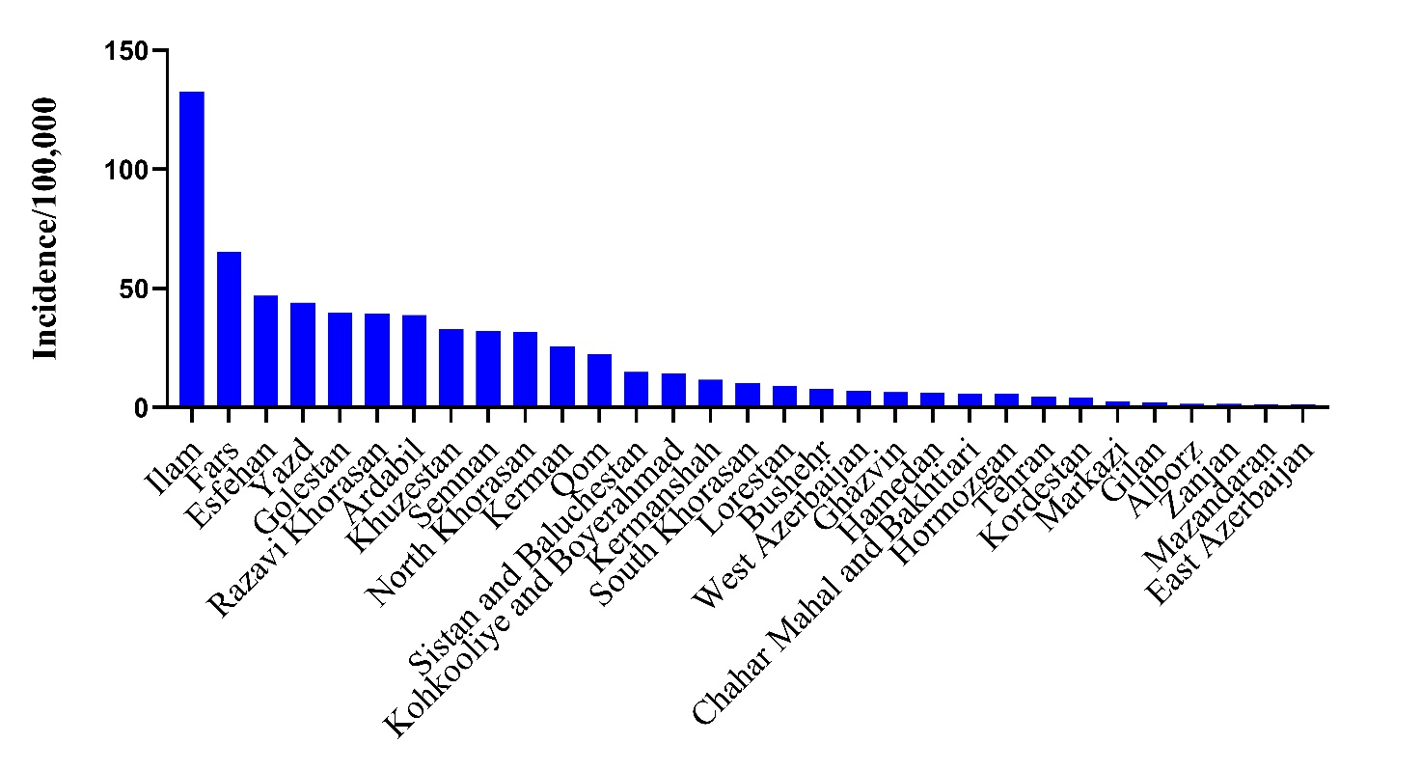
CL endemic provinces in Iran/100,000

Slide 36
Number of cases/ 100,000 population (high incidence provinces), Iran
Provinces | 2013 | 2014 | 2015 | 2016 | 2017 | 2018 | 2019 | 2020 | 2021 | 2022 | 2023 | Average
Ilam | 102.6 | 271.5 | 224.1 | 180.6 | 135 | 77 | 78.7 | 74.6 | 51.5 | 34 | 32.6 | 114.7
Fars | 86.7 | 112.7 | 123.6 | 74.1 | 57 | 59.7 | 40 | 48.8 | 91.6 | 96.7 | 31 | 74.7
Semnan | 28.7 | 30.4 | 29.7 | 48.5 | 30.9 | 41.4 | 95.9 | 175.8 | 74.5 | 20.6 | 8.8 | 53.2
Isfahan | 60.3 | 59.7 | 38.1 | 28.1 | 22.9 | 68.3 | 59.1 | 53.6 | 67.1 | 25.7 | 31.5 | 46.8
Golestan | 32.9 | 36.2 | 43.6 | 51.4 | 33.3 | 75.7 | 60.9 | 33.9 | 21.3 | 30.5 | 28.4 | 40.7
Khuzestan | 19.2 | 80.5 | 60.4 | 34.9 | 31 | 29.7 | 20.7 | 36.1 | 31.3 | 15.3 | 9.1 | 33.5
Khorasan Razavi | 63.9 | 53.3 | 42.7 | 40.5 | 34.5 | 26.4 | 23.4 | 15.4 | 19.3 | 22.3 | 22.4 | 33.1
Khorasan Shomali | 50.7 | 55.5 | 31.1 | 22.6 | 24.8 | 35.5 | 24 | 20 | 36 | 38.2 | 41 | 34.5
Yazd | 27.3 | 33.2 | 41.8 | 26.9 | 16.4 | 36.6 | 21.4 | 32.3 | 44.1 | 36.8 | 30 | 31.5
Kerman | 41.6 | 32.4 | 25.9 | 25.8 | 23.8 | 22.2 | 17.1 | 13.6 | 14.9 | 13.1 | 10.1 | 21.9

Slide 37
Number of cases/ 100,000 population (medium-range incidence provinces), Iran
Provinces | 2013 | 2014 | 2015 | 2016 | 2017 | 2018 | 2019 | 2020 | 2021 | 2022 | 2023 | Average
Qom | 18.8 | 15.3 | 13.4 | 1.8 | 11.8 | 25.7 | 21.3 | 19.6 | 24.3 | 14.4 | 6.6 | 15.7
Sistan and Baluchestan | 13.6 | 15.2 | 9.5 | 6.9 | 5.2 | 6.7 | 12 | 18.6 | 14.9 | 13.1 | 12.1 | 11.6
Kermanshah | 3.5 | 15.5 | 2.4 | 13.2 | 17.9 | 10.3 | 5.9 | 17.9 | 8 | 12.2 | 6.7 | 10.3
Lorestan | 5.9 | 13.3 | 17.8 | 9.2 | 7.7 | 5.5 | 3.8 | 6.7 | 4.4 | 2.7 | 1.1 | 7.1
Bushehr | 11.1 | 12.9 | 12.1 | 7.8 | 5.1 | 9.3 | 2.3 | 3.8 | 5.5 | 7.9 | 3.3 | 7.4
Kohkooliye & Boyerahmad | 7.8 | 12 | 9.8 | 9.8 | 7.2 | 6.1 | 6.7 | 4.9 | 6.9 | 7.1 | 5.3 | 7.6
Hamedan | 2.8 | 9.3 | 12.2 | 8.1 | 9.5 | 6.9 | 4.5 | 5.5 | 5.4 | 4.3 | 3.4 | 6.5
Khorasan Jonoobi | 6.9 | 8.7 | 13.5 | 8.1 | 3.5 | 9 | 4.8 | 3.8 | 4.2 | 8.7 | 13.4 | 7.7
Chahar Mahal and Bakhtiari | 7.4 | 9.5 | 9.1 | 4.7 | 3.6 | 7.6 | 6.1 | 7.7 | 7.1 | 5.4 | 3.1 | 6.5
Hormozgan | 6.4 | 4.7 | 4.9 | 5.7 | 9.1 | 7.6 | 8.4 | 4.3 | 6.3 | 5.1 | 2.6 | 5.9

Slide 38
Number of cases/ 100,000 population (low-range incidence provinces), Iran
Provinces | 2013 | 2014 | 2015 | 2016 | 2017 | 2018 | 2019 | 2020 | 2021 | 2022 | 2023 | Average
Tehran | 1.9 | 2.2 | 2.2 | 2.8 | 2.3 | 3.9 | 3.1 | 3.3 | 3.5 | 3.5 | 2.4 | 2.8
Markazi | 1.5 | 3 | 1.8 | 2.6 | 2.8 | 4.1 | 2.2 | 3.7 | 12.8 | 4.9 | 1.8 | 3.7
Alborz | 1.1 | 2.1 | 2 | 1.9 | 1.7 | 2 | 2.4 | 2.5 | 2.4 | 2.7 | 2.1 | 2.1
Mazandaran | 1.5 | 1.4 | 1.2 | 1.8 | 1.4 | 1.4 | 1.6 | 2.2 | 1.4 | 1.5 | 1.2 | 1.5
Ardabil | 1.4 | 2 | 1.2 | 1.6 | 2 | 1.9 | 0.6 | 1.5 | 0.9 | 0.5 | 0.4 | 1.3
Ghazvin | 1.1 | 0.7 | 0.5 | 0.5 | 2.9 | 2.1 | 1.3 | 1.4 | 1.3 | 0.8 | 1.4 | 1.3
Kordestan | 0.5 | 1.6 | 2.4 | 1.5 | 2.4 | 0.7 | 0.4 | 0.6 | 0.4 | 0.2 | 0.4 | 1.0
East Azerbaijan | 0.8 | 1.3 | 1.4 | 1.3 | 1.1 | 1.2 | 1.3 | 1.4 | 0.8 | 0.5 | 0.4 | 1.0
West Azerbaijan | 0.4 | 0.9 | 1.1 | 0.6 | 1.1 | 0.8 | 1 | 1 | 0.8 | 0.5 | 0.3 | 0.8
Zanjan | 0.5 | 0.5 | 0.5 | 1.1 | 1 | 1.2 | 0.5 | 0.7 | 0.1 | 0.5 | 0.3 | 0.6

Slide 39
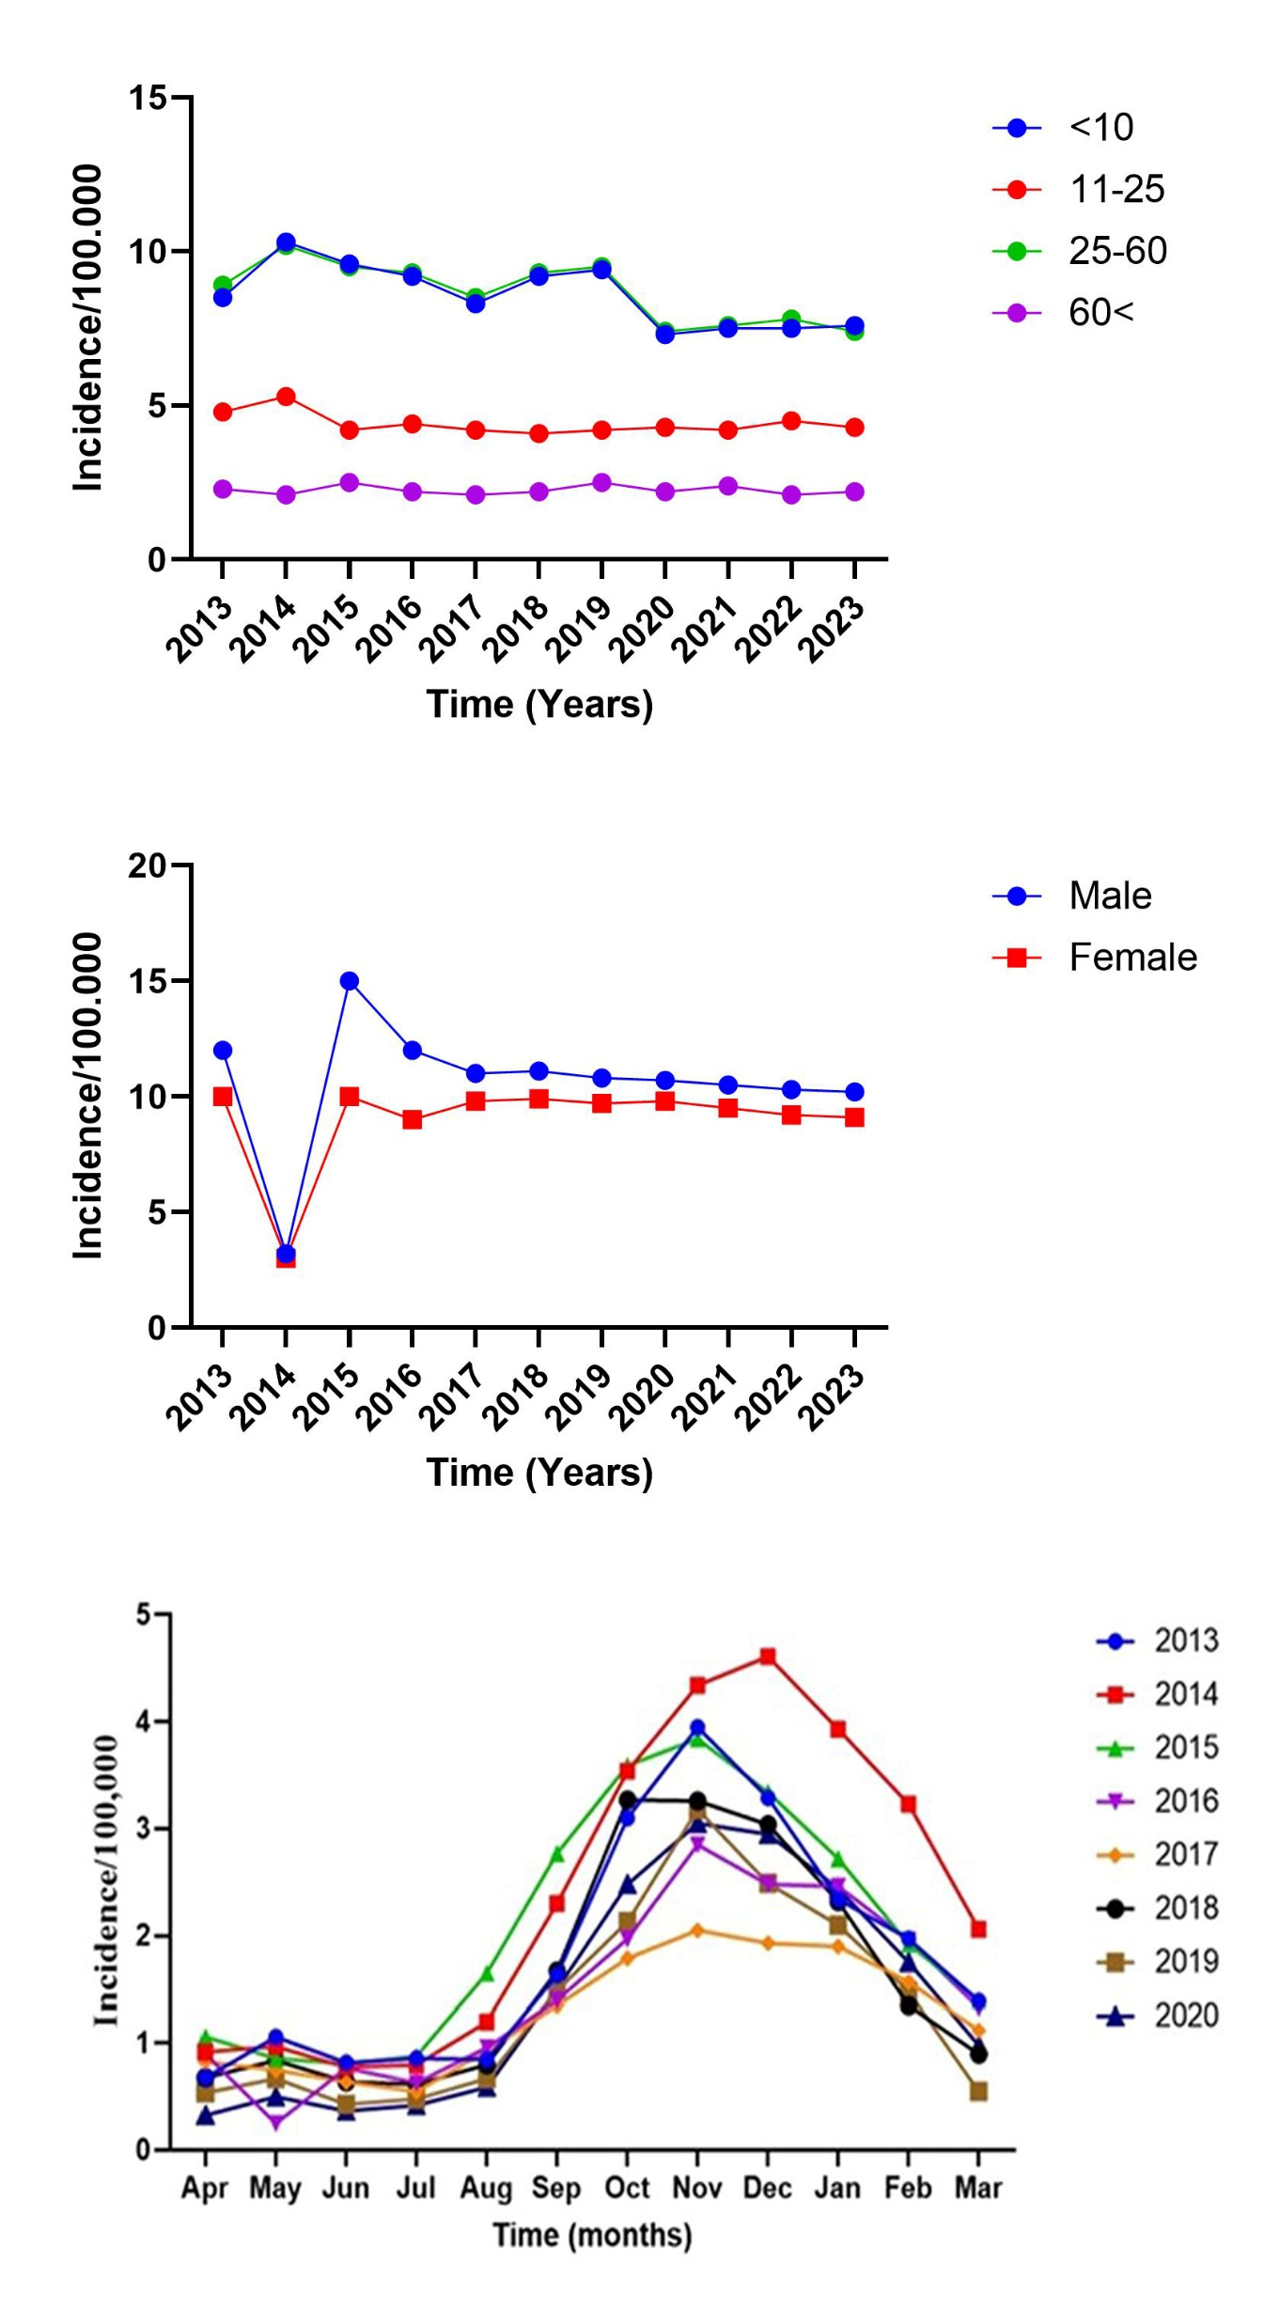

Slide 41
Conclusions
L. major, is zoonotic
More common in dry, desert-like and steppe regions
Facilitating higher risk in rural areas with populations of gerbils
It occurs in acute course with a short duration of disease
Control strategies should be focused on gerbils

Slide 42
While L.tropica, is anthroponotic
Found in urban-areas (medium and large-sized cities), notably where there is lack of housing conditions, rapid urbanization, population displacement and poor waste management.
This species is more frequently associated with drug resistant mutans.
It persists more likely in chronic form and may relapse every so often.

Slide 43


